Slide 1

Guru Gobind Singh College of Engineering and Research Center, Nashik.
Department of Computer Engineering
Academic Year: 2024-25
Final Year Project Work
Review IV.II
Group ID | G-8
Project Title | AI PRESENTATION TOOL USING GESTURE RECOGNITION
Team Members | 1. Ayesha Shaikh
 | 2. Pooja Gupta
 | 3. Shiba Shaikh
 | 4. Anushka Jadhav
Guide Name | Mrs. P. K. Bachhav

Slide 2

ABSTRACT
The proposed idea AI Presentation Tool Using Gesture Recognition introduces an innovative AI-driven presentation tool that utilizes hand gestures for controlling PowerPoint slides, aiming to transform the presentation experience. By enabling presenters to interact with their slides through natural movements, the tool eliminates the reliance on traditional physical devices, such as remotes or keyboards, fostering a more fluid and engaging atmosphere. The system employs advanced computer vision and deep learning techniques to accurately recognize hand gestures in real-time, providing a hands-free solution that is particularly beneficial for users with physical disabilities. The proposed tool not only simplifies the act of presenting but also enhances accessibility, making it an ideal fit for diverse environments, including classrooms, corporate meetings, conferences, and virtual settings. By leveraging recent advancements in AI technology, the proposed idea aspires to redefine the standards of interactivity and inclusivity in presentation tools, making presentations more dynamic and accessible to a wider audience. In this paper we have included study of existing papers and methodology of proposed system
Guru Gobind Singh College of Engineering, Nashik

Slide 3
INTRODUCTION
Traditional presentation tools (clickers, keyboards) interrupt natural flow and reduce audience engagement.
These tools also pose accessibility challenges for individuals with disabilities.
The proposed solution: an AI-powered presentation tool using gesture recognition for hands-free slide control.
Utilizes computer vision and deep learning to interpret real-time hand movements.
Enhances focus, interactivity, and inclusivity in presentations.
Features an intuitive interface for smooth navigation and dynamic interaction.
Benefits professionals, educators, and differently-abled users alike.
Guru Gobind Singh College of Engineering, Nashik

Slide 4
LITERATURE SURVEY
Name of paper | Authors | Date Of Publication | Working | Merits | Demerits
The Future of Interactive Presentations: Gesture and Touch | J. P. Brown | 2022 | Discusses the combination of gesture and touch technologies for next-gen presentations. | Provides hybrid interaction model (gesture + touch); future-ready approach. | Complex system integration; may not be suitable for all users.

Slide 5
LITERATURE SURVEY
Name of paper | Authors | Date Of Publication | Working | Merits | Demerits
Enhancing Presentations with Gesture Recognition Technologies | A. Lee, B. Chan | 2022 | Implements a system using depth cameras and skeletal tracking for controlling slides and pointer with hand gestures. | Real-time control, robust gesture differentiation | Hardware dependency (depth camera required); not cost-effective.

Slide 6
LITERATURE SURVEY
Name of paper | Authors | Date Of Publication | Working | Merits | Demerits
A Study on Gesture Recognition in Interactive Presentations | M. K. Jha, A. D. Gupta | 2022 | Analyzes different gesture recognition methods and compares their effectiveness for interactive slides. | Detailed comparison of algorithms (CNN, HMM, etc.); insights on gesture datasets. | Theoretical focus; lacks a practical implementation model.

Slide 7
LITERATURE SURVEY
Name of paper | Authors | Date Of Publication | Working | Merits | Demerits
Utilizing Kinect for Enhanced Presentation Control | L. Zhang | 2022 | Uses Microsoft Kinect sensor to detect body and hand gestures for controlling slides, cursor, and other interactive elements during presentations. | High precision with skeletal tracking; enables natural user interaction; supports full-body gestures. | Limited to Kinect hardware; bulky setup and lack of portability; compatibility issues with modern systems.

Slide 8
LITERATURE SURVEY
Name of paper | Authors | Date Of Publication | Working | Merits | Demerits
Gesture Recognition: Applications in Education and Presentations | S. R. Patel | 2023 | Focuses on integrating gesture recognition into educational tools and presentation systems using machine learning. | High accuracy in classroom settings; adaptable to various platforms. | Requires high-quality hardware and stable lighting for accuracy.

Slide 9
CONCLUSION FROM LITERATURE SURVEY
The literature survey highlights the advancements in gesture recognition technology for enhancing user engagement in presentations. While gesture-based control provides a hands-free experience, challenges such as environmental dependency, complexity in gesture recognition, and hardware limitations persist. Integrating machine learning techniques shows promise for improving accuracy and adaptability, but further refinement is needed to enhance reliability across diverse conditions. Future research should aim to develop more flexible and robust systems for broader device compatibility, ultimately transforming presentation delivery through improved user interaction.
Guru Gobind Singh College of Engineering, Nashik

Slide 10
IMPLEMENTATION
Developed a desktop-based AI presentation tool using Python, integrating gesture recognition and voice commands for contactless control.
Implemented gesture detection using MediaPipe and OpenCV; mapped gestures to actions via PyAutoGUI.
Enabled voice-controlled slide navigation using speech recognition APIs (Vosk).
Integrated real-time subtitle generation with optional multi-language translation using DeepTranslator.
Built a lightweight GUI with Tkinter to start/stop features, toggle settings, and display live feedback.
Ensured offline functionality for gesture recognition to increase accessibility and reliability.
Used MySQL to store user data, gesture preferences, and system settings securely and efficiently.
Guru Gobind Singh College of Engineering, Nashik

Slide 11
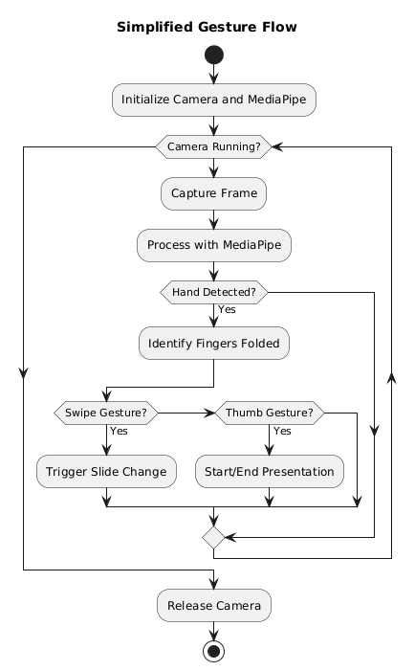
ALGORITHMS
Algorithm for Recognizing Default Gesture
Guru Gobind Singh College of Engineering, Nashik

Slide 12
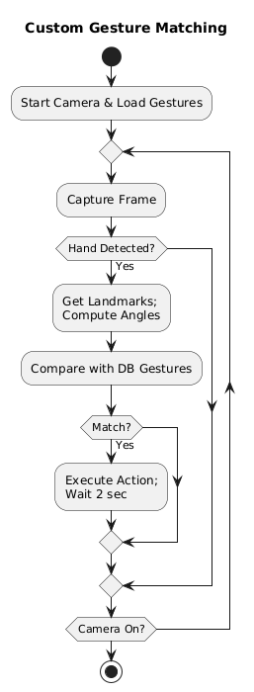
ALGORITHMS
Algorithm for Recognizing Custom Gesture
Guru Gobind Singh College of Engineering, Nashik

Slide 13
METHODOLOGY
Design
Preliminary design for the system
Develop Prototype
Functional prototype highlighting key features
Evaluate Prototype
Gather feedback from users and team members
Review and Refine
Improving & adding functionalities
high-level architecture
Requirement Analysis
Core functionalities
Additional requirements
Primary needs
Final Product
Validated prototype
Testing
Unit, integration & system testing
Maintenance
Future upgrades & expansions
User-reported issues
Deployment
smooth installation & operation in user environment
Prototype Model
Guru Gobind Singh College of Engineering, Nashik

Slide 14
TEST CASES
Gesture Control Module:
TID | Description | Steps | Expected Output | Actual Output | Pass/Fail
GC-01 | Detect swipe right gesture for next slide | Start the application 2. Perform a right swipe gesture | Slide moves to the next | Slide moves to the next | Pass
GC-02 | Detect swipe left gesture for previous slide | Start the application 2. Perform a left swipe gesture | Slide moves to the previous | Slide moves to the previous | Pass
GC-03 | Detect thumb-up gesture to start presentation | Start the application. Show thumb-up gesture | Presentation starts | Presentation starts | Pass
Guru Gobind Singh College of Engineering, Nashik

Slide 15
TEST CASES
Gesture Control Module:
TID | Description | Steps | Expected Output | Actual Output | Pass/Fail
GC-04 | Detect thumb-down gesture to end presentation | 1. Start the application. Show thumb-down gesture | Presentation ends | Presentation ends | Pass
GC-05 | Lock gestures using voice command | Start the application Say "Lock gestures" | Gestures are locked and status message displayed | Gestures are locked and status message displayed | Pass
GC-06 | Resume gestures using voice command | Start the application. Say "Resume gestures" | Gestures are unlocked and status message displayed | Gestures are unlocked and status message displayed | Fail
Guru Gobind Singh College of Engineering, Nashik

Slide 16
TEST CASES
Gesture Control Module:
TID | Description | Steps | Expected Output | Actual Output | Pass/Fail
GC-07 | Ignore unrecognized gestures | 1. Start the application. Perform a random hand movement | No action is triggered | No action is triggered | Pass
GC-08 | Ignore unrecognized voice commands | Start the application Say an unrelated word(e.g., "Hello") | No action is triggered | No action is triggered | Pass
Guru Gobind Singh College of Engineering, Nashik

Slide 17
TEST CASES
Voice Control Module:
TID | Description | Steps | Expected Output | Actual Output | Pass/Fail
VC-01 | Recognize 'next' command and navigate | 1. Start application 2. Say "Next slide" | Moves to next slide | Moves to next slide | Pass
VC-02 | Recognize 'previous' command and navigate | 1. Start application 2. Say "Previous slide" | Moves to previous slide | Moves to previous slide | Pass
VC-03 | Recognize 'go to slide [number]' command | 1. Start application 2. Say "Go to slide 5" | Navigates to slide 5 | Navigates to slide 5 | Pass
Guru Gobind Singh College of Engineering, Nashik

Slide 18
TEST CASES
Voice Control Module:
TID | Description | Steps | Expected Output | Actual Output | Pass/Fail
VC-04 | Recognize 'start presentation' command | 1. Start application 2. Say "Start presentation" | Starts slideshow | Starts slideshow | Pass
VC-05 | Recognize 'stop presentation' command | 1. Start application 2. Say "Stop presentation" | Exits slideshow | Exits slideshow | Pass
VC-06 | Ignore unrecognized commands | 1. Start application 2. Say an unrelated word (e.g., "Hello") | No action triggered | No action triggered | Pass
VC-07 | Handle incorrect slide number input | 1. Start application 2. Say "Go to slide 999" (invalid slide) | No navigation occurs | No navigation occurs | Pass
Guru Gobind Singh College of Engineering, Nashik

Slide 19
TEST CASES
Real-time Subtitles Module:
TID | Description | Steps | Expected Output | Actual Output | Pass/Fail
RTS-01 | Recognize and display spoken words | 1. Start application 2. Speak clearly into the microphone | Spoken words appear as subtitles | Spoken words appear as subtitles | Pass
RTS-02 | Handle no speech input | 1. Start application 2. Stay silent for 10 seconds | Subtitle overlay remains empty | Subtitle overlay remains empty | Pass
RTS-03 | Start subtitles overlay | 1. Start application 2. Call start_subtitle() function | Subtitle overlay appears on screen | Subtitle overlay appears on screen | Pass
RTS-04 | Stop subtitles overlay | 1. Start application 2. Call stop_subtitle() function | Subtitle overlay disappears | Subtitle overlay disappears | Pass
Guru Gobind Singh College of Engineering, Nashik

Slide 20
TEST CASES
Real-time Translation Module:
TID | Description | Steps | Expected Output | Actual Output | Pass/Fail
RTT-01 | Start real-time translation | 1. Start application 2. Call start_real_time_translation() function | Translation overlay appears on screen | Translation overlay appears on screen | Pass
RTT-02 | Stop translation overlay | 1. Start application 2. Call stop_real_time_translation() function | Translation overlay disappears | Translation overlay disappears | Pass
RTT-03 | Verify English to Hindi translation | 1. Start application 2. Select 'English to Hindi' option 3. Speak in English | Translated text appears in Hindi | Translated text appears in Hindi | Pass
RTT-04 | Verify Hindi to English translation | 1. Start application 2. Select 'Hindi to English' option 3. Speak in Hindi | Translated text appears in English | Subtitle overlay disappears | Pass
Guru Gobind Singh College of Engineering, Nashik

Slide 21
TEST CASES
Real-time Translation Module:
TID | Description | Steps | Expected Output | Actual Output | Pass/Fail
RTT-05 | Verify English to French translation | 1. Start application 2. Select 'English to French' option 3. Speak in English | Translated text appears in French | Translated text appears in French | Pass
RTT-06 | Verify English to German translation | 1. Start application 2. Select 'English to German' option 3. Speak in English | Translated text appears in German | Translated text appears in German | Pass
RTT-07 | Handle non-supported language input | 1. Start application 2. Speak in an unsupported language | Displays ‘Could not understand Audio’ | Displays ‘Could not understand Audio’ | Pass
Guru Gobind Singh College of Engineering, Nashik

Slide 22
TEST CASES
Customized Gesture Module:
TID | Description | Steps | Expected Output | Actual Output | Pass/Fail
CG-01 | Store a new custom gesture in database | 1. Start application 2. Perform a new gesture 3. Assign an action and save | Gesture is saved in the database with angles and image | Translation overlay appears on screen | Pass
CG-02 | Retrieve stored gestures from database | 1. Start application 2. Navigate to gesture management 3. View stored gestures | List of stored gestures is displayed | List of stored gestures is displayed | Pass
CG-03 | Detect a saved custom gesture and execute action | 1. Start application 2. Perform a stored custom gesture | Corresponding action (next slide) is triggered | Corresponding action (next slide) is triggered | Pass
Guru Gobind Singh College of Engineering, Nashik

Slide 23
TEST CASES
Customized Gesture Module:
TID | Description | Steps | Expected Output | Actual Output | Pass/Fail
CG-04 | Delete a stored custom gesture | 1. Start application 2. Navigate to gesture management 3. Delete a gesture | Gesture is removed from the database | Translation overlay appears on screen | Pass
CG-05 | Update an existing gesture | 1. Start application 2. Navigate to gesture management 3. Select a gesture and update it | Gesture angles and image are updated | Gesture angles and image are updated | Pass
CG-06 | Handle duplicate gestures for different actions | 1. Start application 2. Try saving two different actions with similar gestures | The system detects duplicate gesture assignments and displays a warning. | Latest updated Gesture gets executed | Fail
Guru Gobind Singh College of Engineering, Nashik

Slide 24
TEST CASES
Login & Register Functionality:
TID | Description | Steps | Expected Output | Actual Output | Pass/Fail
TT-01 | Successful Login | 1. Navigate to login page. 2. Enter valid username and password. 3. Click the login button. | Dashboard is displayed after successful login. | Dashboard displayed | Pass
TT-02 | Successful Registration | 1. Navigate to the registration page. 2. Fill in all required fields with valid data. 3. Click the register button. | A confirmation message is shown and the user is redirected dashboard | Successfully registered | Pass
Guru Gobind Singh College of Engineering, Nashik

Slide 25
TEST CASES
Login & Register Functionality:
TID | Description | Steps | Expected Output | Actual Output | Pass/Fail
TT-03 | Unsuccessful Login with Invalid Credentials | 1. Navigate to login page. 2. Enter invalid username and/or password. 3. Click the login button. | Error message "Invalid credentials" is displayed | Error message "Invalid credentials" is displayed | Pass
TT-04 | Registration Failure for Existing User Account | 1. Navigate to the registration page. 2. Enter details for an already registered email/username. 3. Click the register button. | Error message "User already exists" is displayed, and the account is not created. | Error message displayed | Pass
Guru Gobind Singh College of Engineering, Nashik

Slide 26
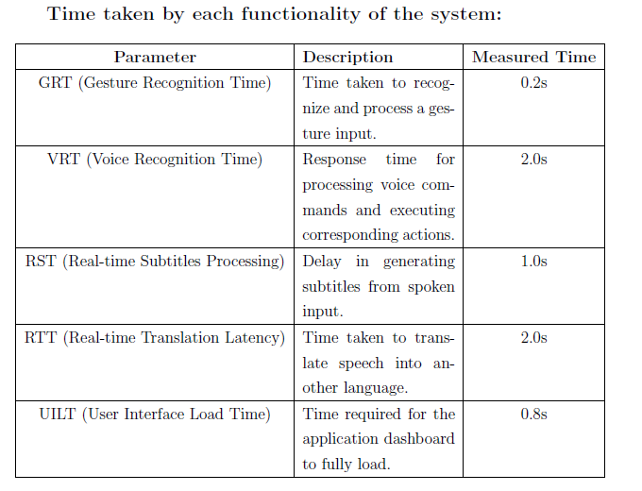
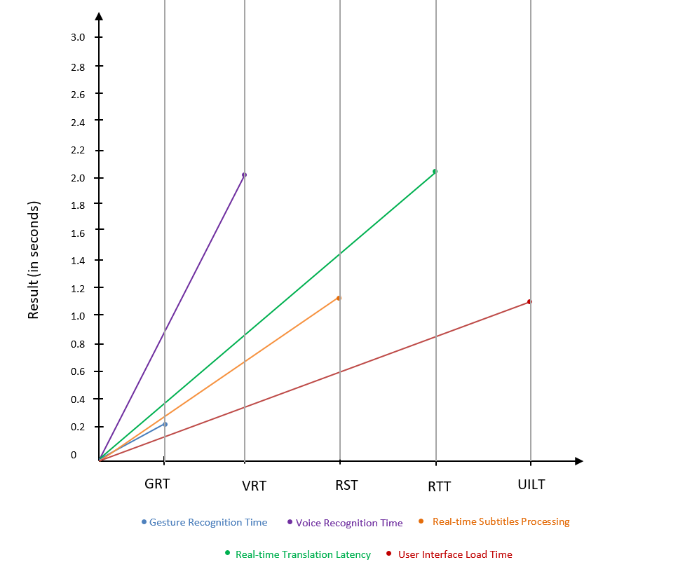
RESULTS
Guru Gobind Singh College of Engineering, Nashik

Slide 27
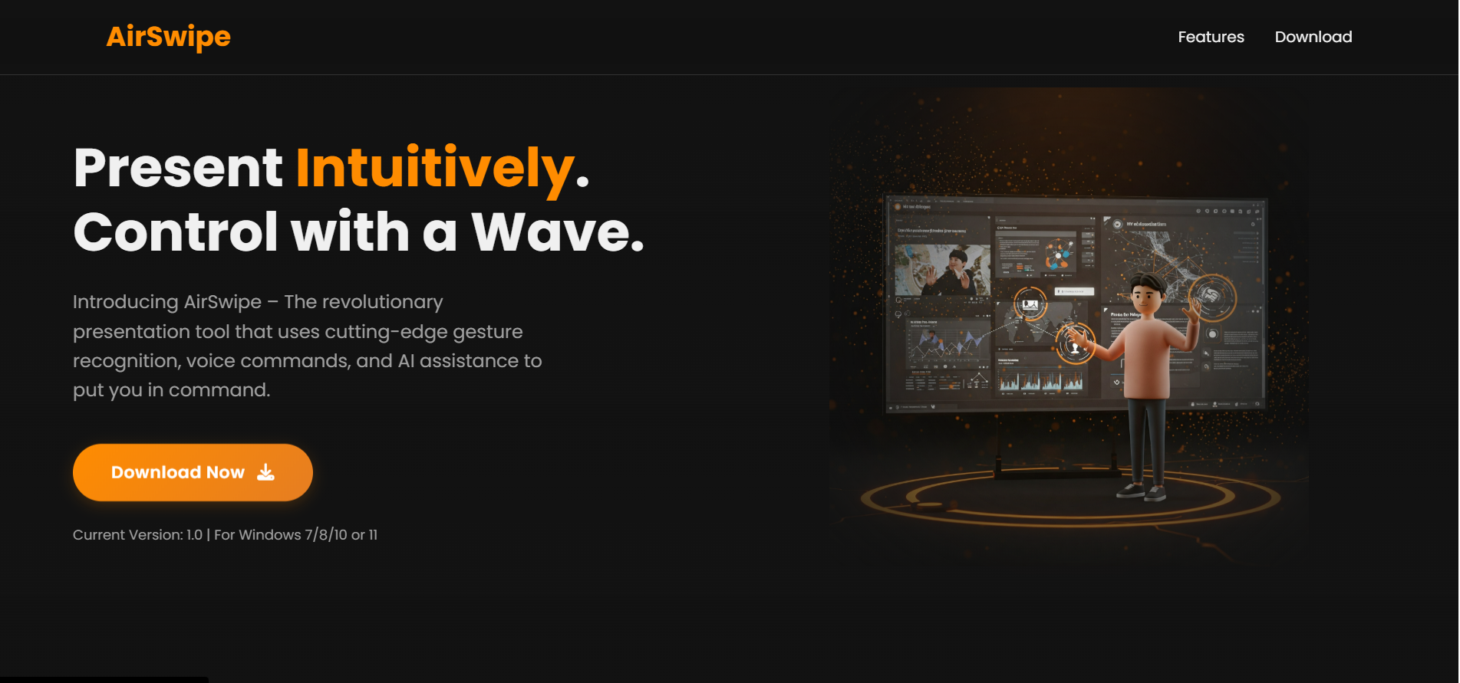
DEPLOYMENT
https://airswipe.netlify.app/

Slide 28
CONCLUSION
The proposed system aims to revolutionize the way users interact with presentation tools. By integrating gesture recognition and voice commands, users can control slides naturally and efficiently. Additionally,real-time subtitle generation and speech translation makes the system highly inclusive, allowing it to be used in educational seminars, business meetings, and multilingual conferences. Through this hands-free and AI-based interaction, the tool enhances accessibility, reduces dependency on hardware tools like remotes or clickers, and brings innovation to the presentation experience.
Guru Gobind Singh College of Engineering, Nashik

Slide 29
REFERENCES
[1] R. M. Shakya, S. P. Sharma, and N. Shrestha, ”The Use of Hand Gestures as a Tool for Presentation,” International Journal of Advanced Computer Science and Applications, vol. 14, no. 11, 2023.
[2] S. R. Patel, ”Gesture Recognition: Applications in Education and Presentations,” IEEE Transactions on Human-Machine Systems, vol. 53, no. 3, pp. 250-260, 2023.
[3] M. K. Jha and A. D. Gupta, ”A Study on Gesture Recognition in Interactive Presentations,” ITM Conference Proceedings, ICACC 2022.
[4] A. Lee and B. Chan, ”Enhancing Presentations with Gesture Recognition Technologies,” IEEE Access, vol. 10, pp. 500-510, 2022.
[5] J. P. Brown, ”The Future of Interactive Presentations: Gesture and Touch,” IEEE Transactions on Education, vol. 65, no. 2, pp. 120-130, 2022.
Guru Gobind Singh College of Engineering, Nashik

Slide 30
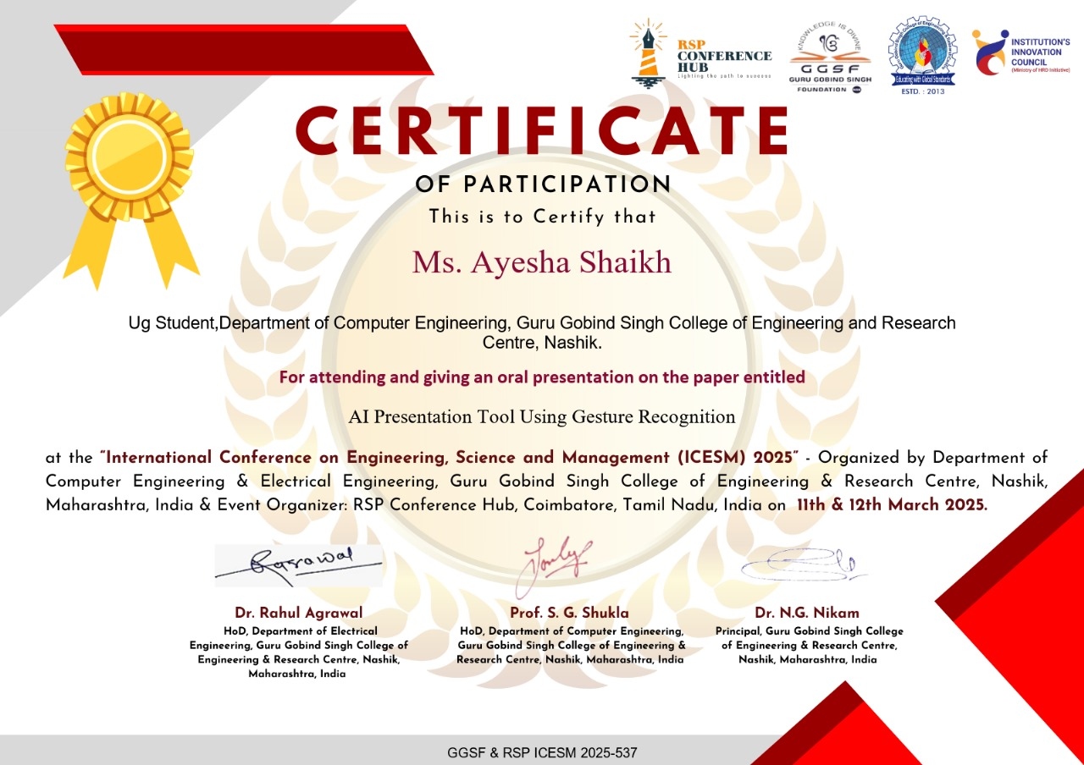

CONFERENCE PAPER PRESENTATION DETAILS
We have participated in International Conference on Engineering Science and Management(
ISCEM) 2025
Guru Gobind Singh College of Engineering, Nashik

Slide 31
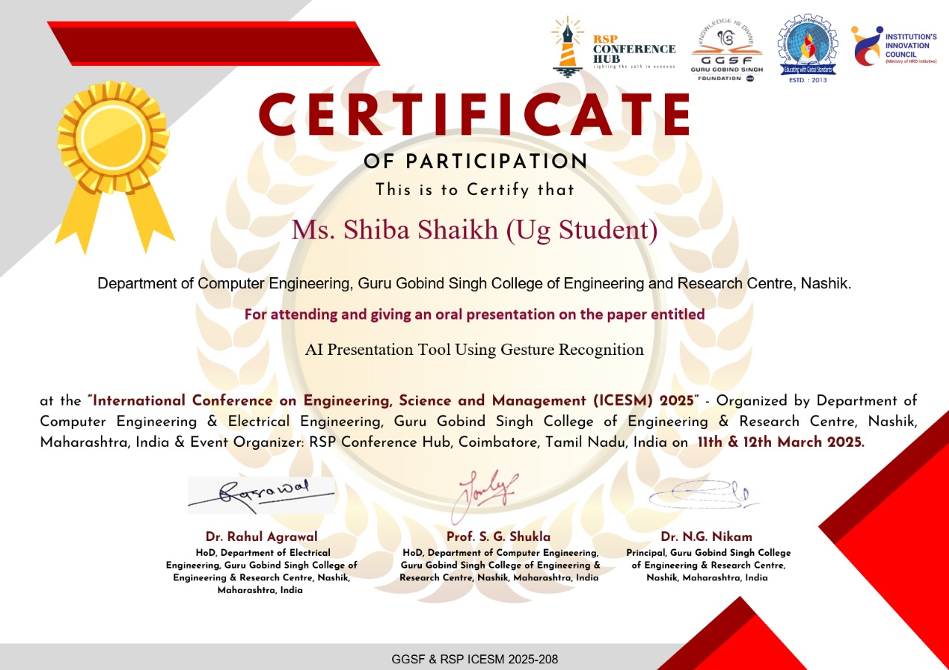

CONFERENCE PAPER PRESENTATION DETAILS
We have participated in International Conference on Engineering Science and Management(
ISCEM) 2025
Guru Gobind Singh College of Engineering, Nashik

Slide 32
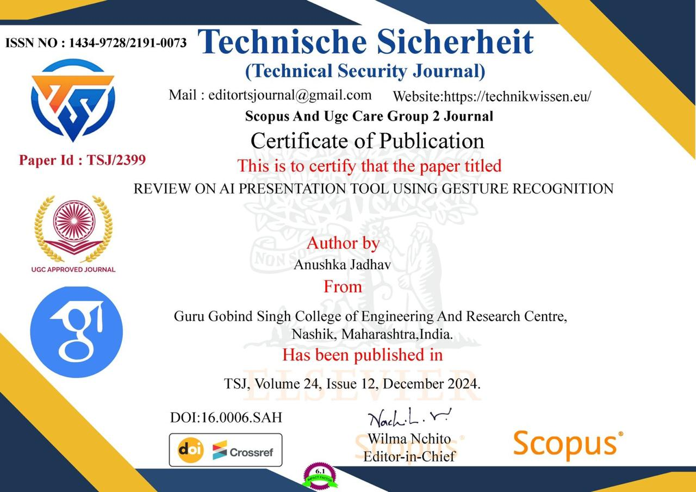

PAPER PUBLICATION DETAILS
We have Published paper in Technical Security Journal on ”Review on AI Presentation Tool Using Gesture Recognition”
Paper ID: TSJ/2399, ISSN-1434-9728/2191-0073.
Guru Gobind Singh College of Engineering, Nashik

Slide 33


PAPER PUBLICATION DETAILS
We have Published paper in Technical Security Journal on ”Review on AI Presentation Tool Using Gesture Recognition”
Paper ID: TSJ/2399, ISSN-1434-9728/2191-0073.
Guru Gobind Singh College of Engineering, Nashik

Slide 34
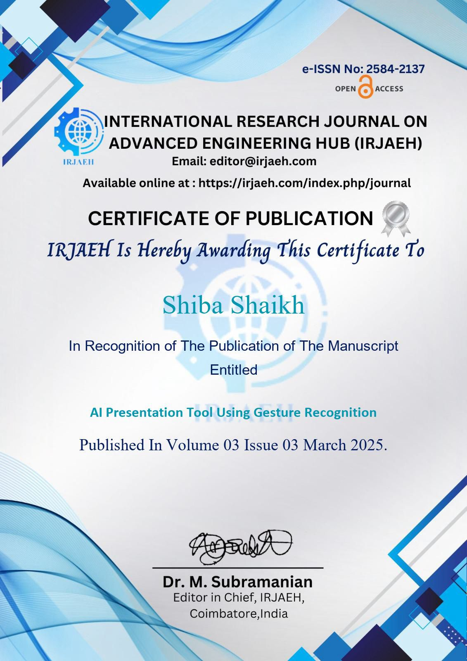
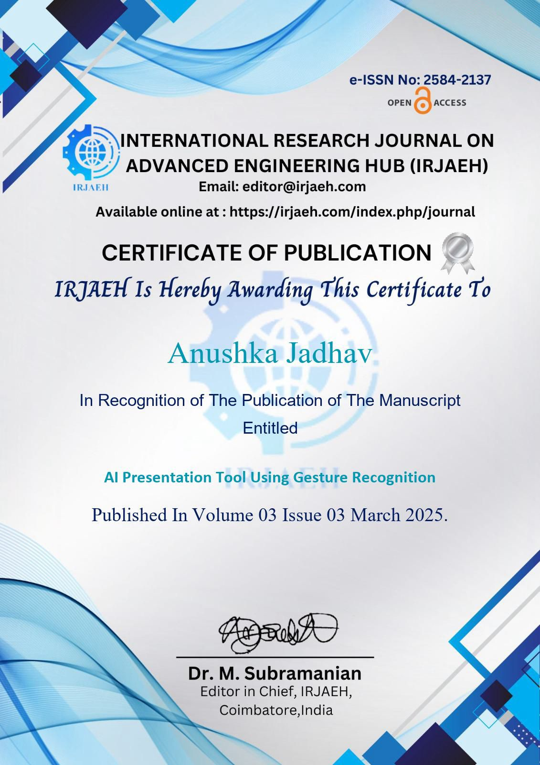
PAPER PUBLICATION DETAILS
We have Published paper in International Research Journal on Advanced Engineering Hub(IRJAEH) on ”AI Presentation Tool Using Gesture Recognition”, ISSN- 2584-2137.
Guru Gobind Singh College of Engineering, Nashik

Slide 35

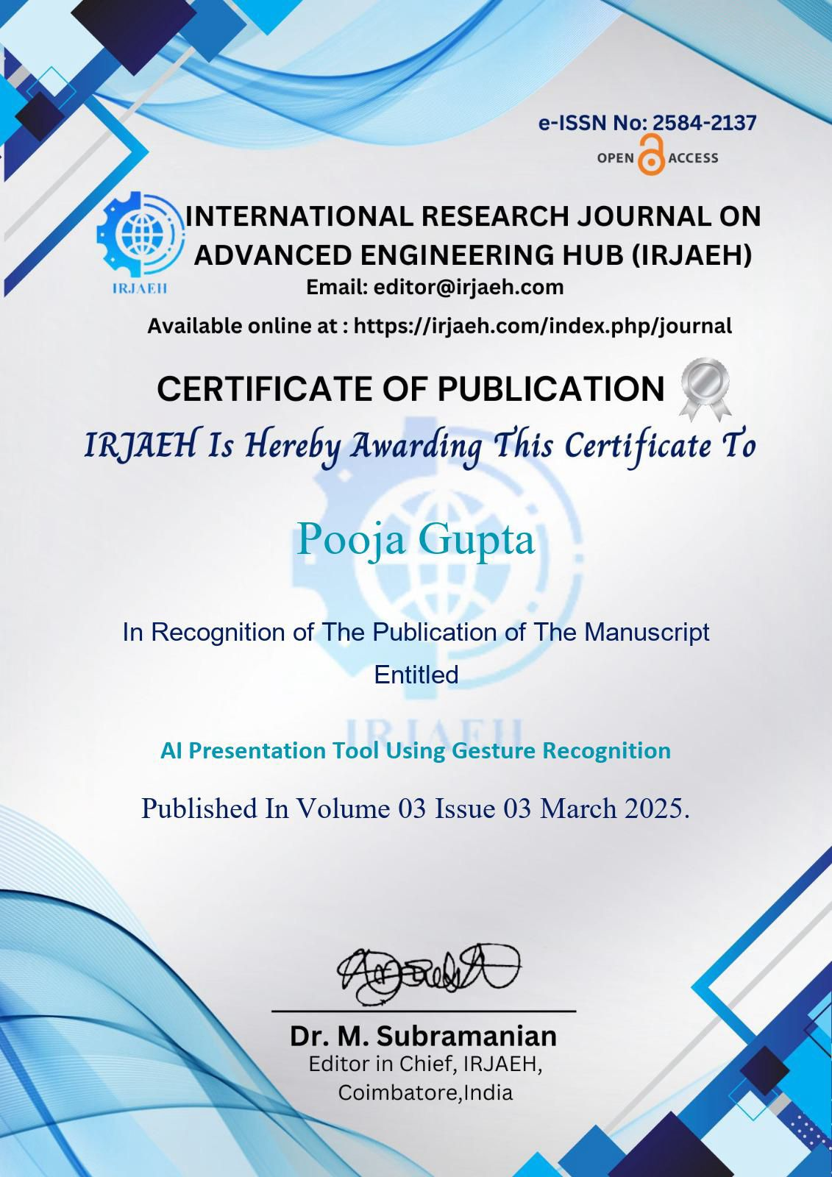
PAPER PUBLICATION DETAILS
We have Published paper in International Research Journal on Advanced Engineering Hub(IRJAEH) on ”AI Presentation Tool Using Gesture Recognition”, ISSN- 2584-2137.
Guru Gobind Singh College of Engineering, Nashik

Slide 36
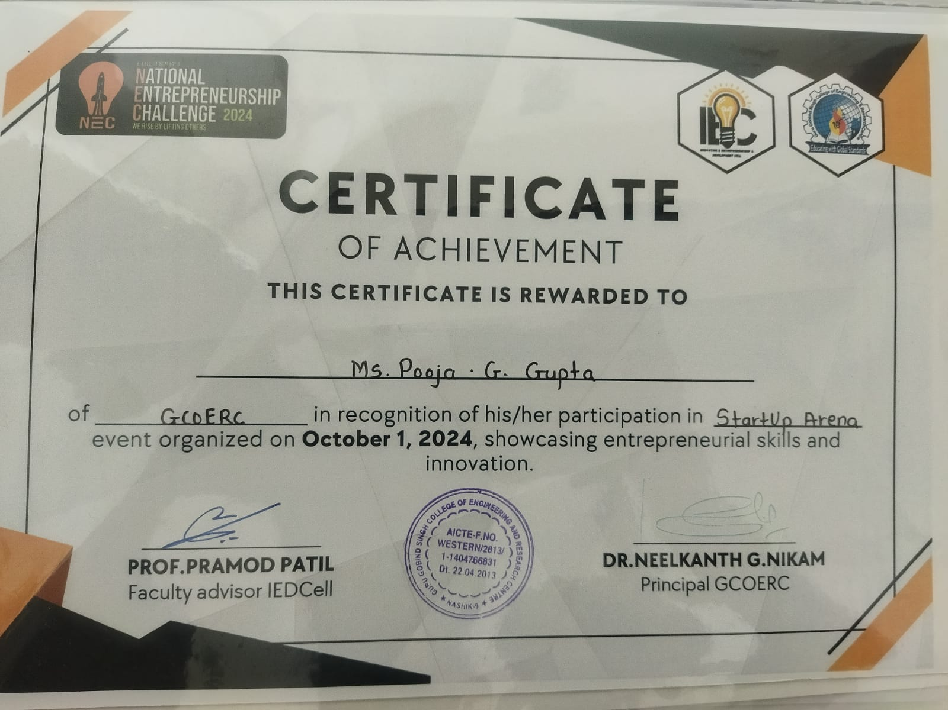
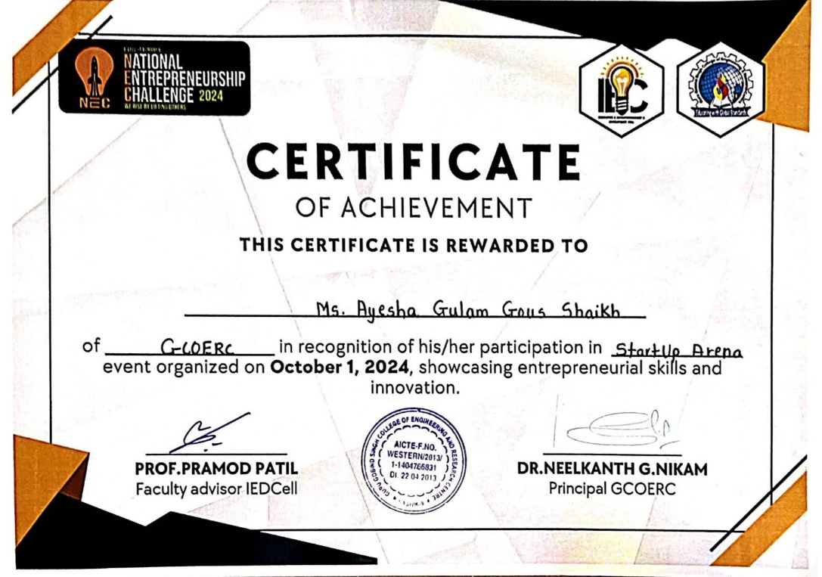

PROJECT COMPETITION DETAILS
Startup Arena(National Entrepreneurship Challenge 2024)
Guru Gobind Singh College of Engineering, Nashik

Slide 37
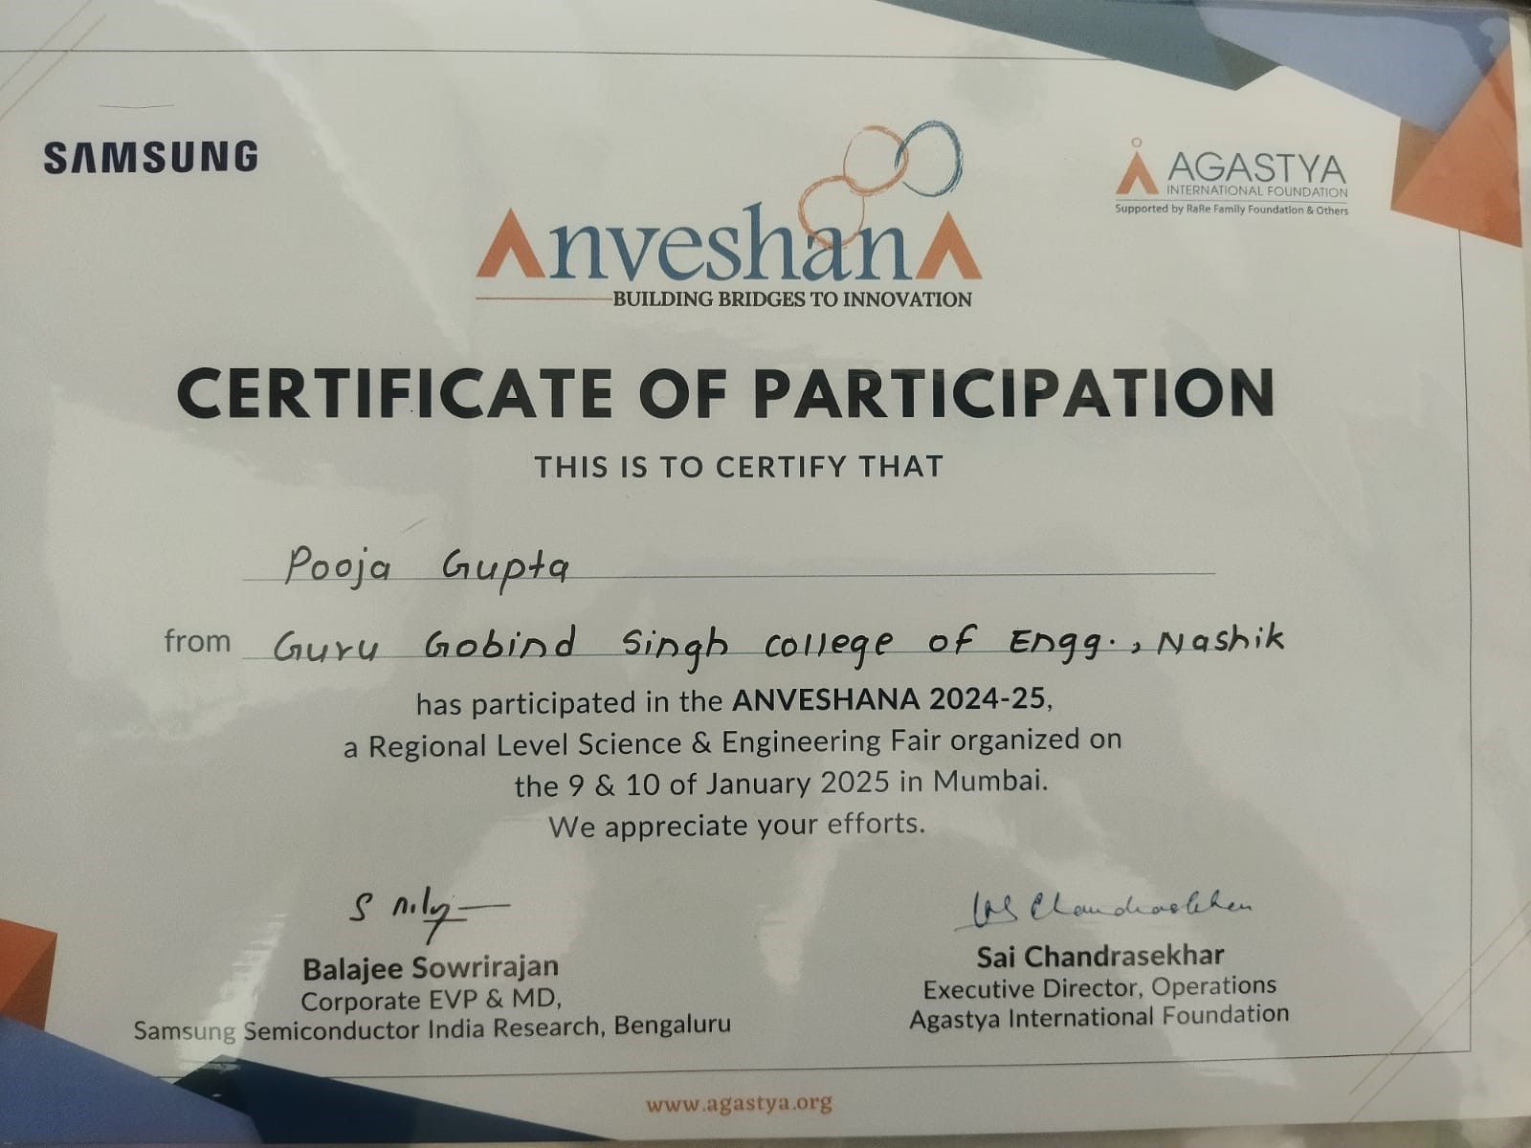
PROJECT COMPETITION DETAILS
ANVESHANA 2024-25 a Regional Level Science & Engineering Fair organized in Mumbai by AGASTYA INTERNATIONAL FOUNDATION.
Guru Gobind Singh College of Engineering, Nashik

Slide 38
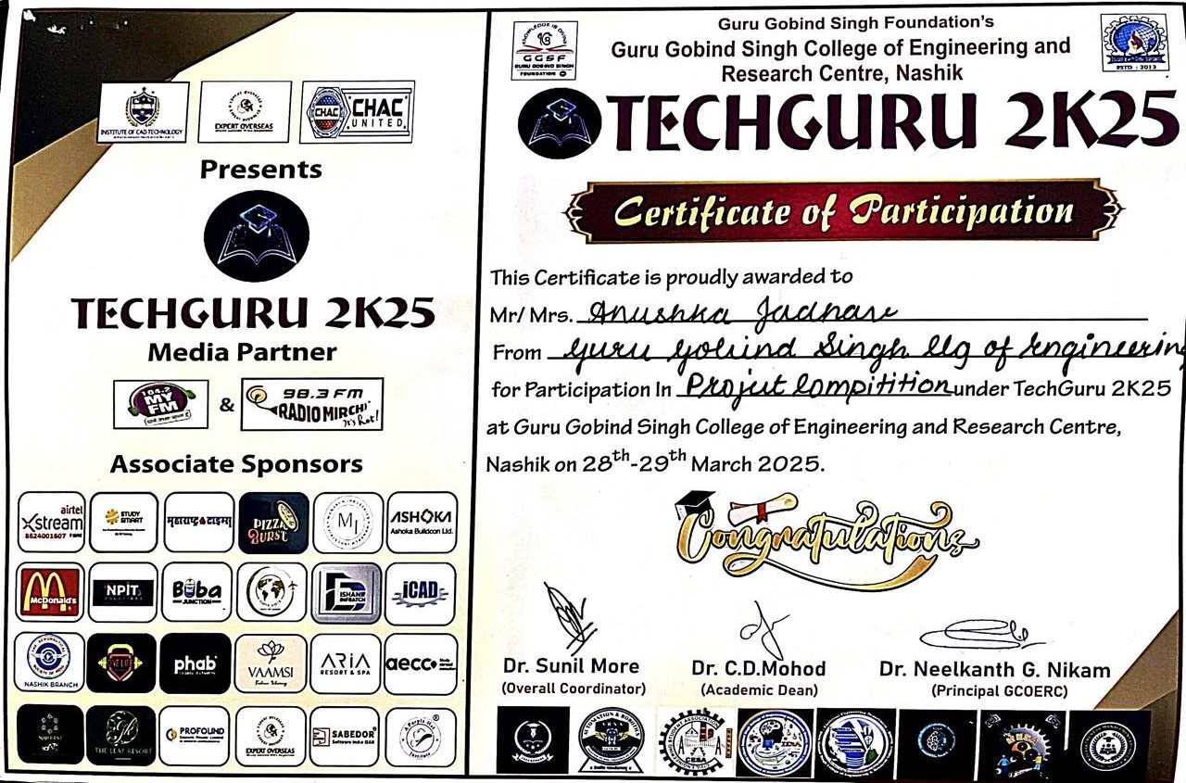
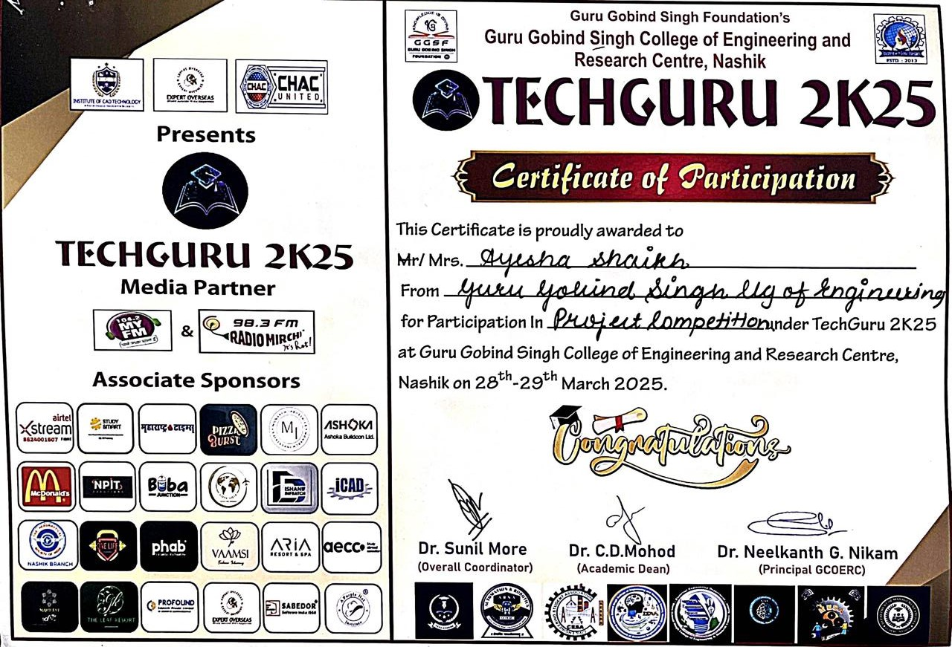
PROJECT COMPETITION DETAILS
TECH-GURU, 2K25 Organized by Guru Gobind Singh College of Engineering & Research Centre, Nashik.
Guru Gobind Singh College of Engineering, Nashik

Slide 39
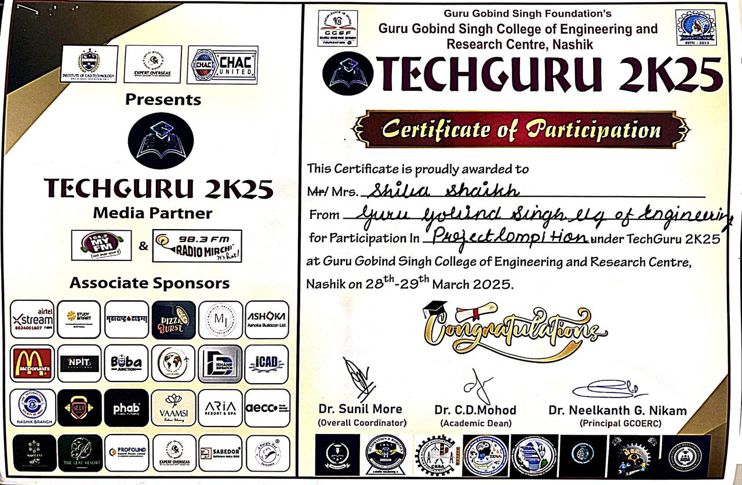
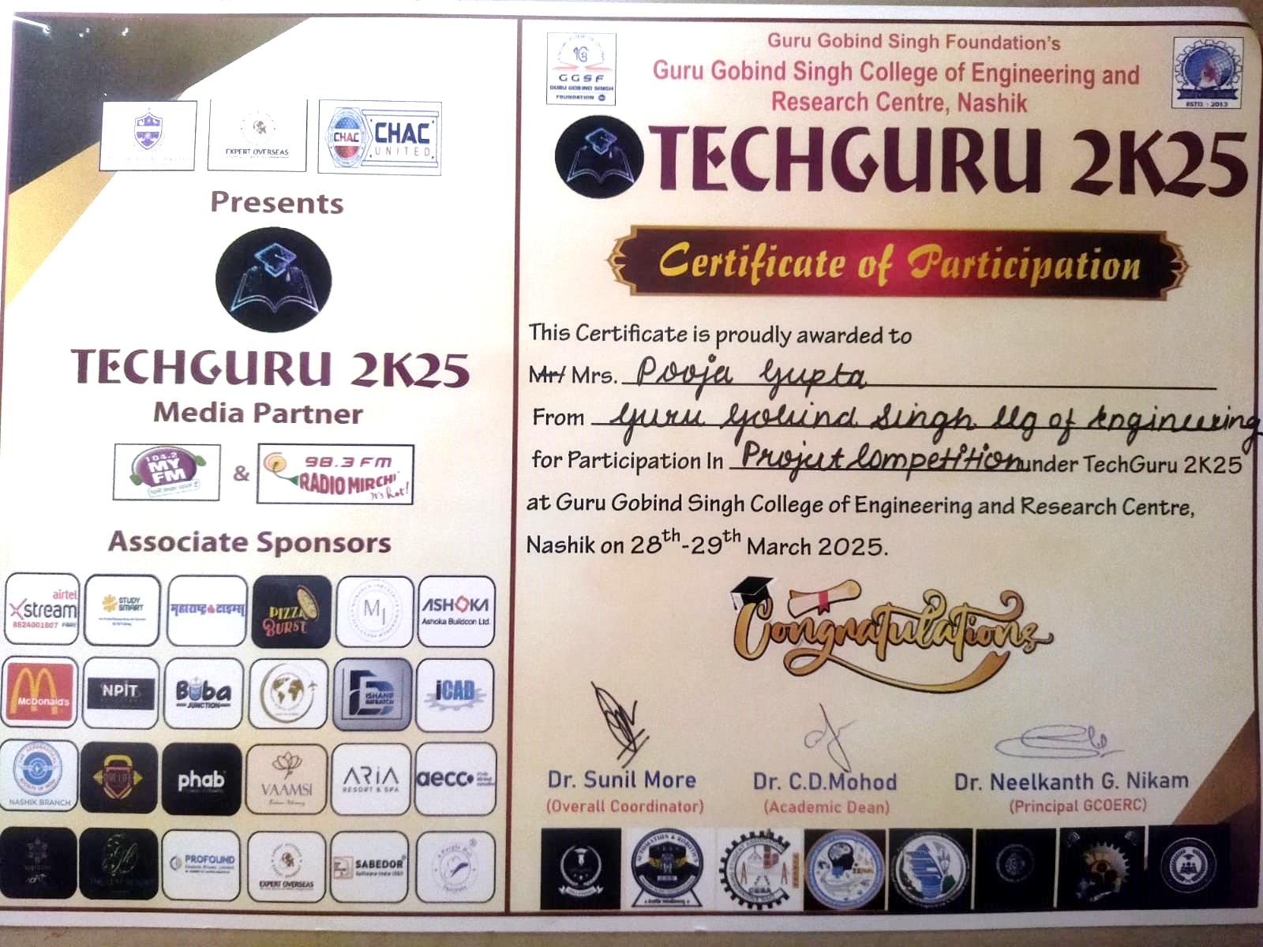
PROJECT COMPETITION DETAILS
TECH-GURU, 2K25 Organized by Guru Gobind Singh College of Engineering & Research Centre, Nashik.
Guru Gobind Singh College of Engineering, Nashik

